Slide 1
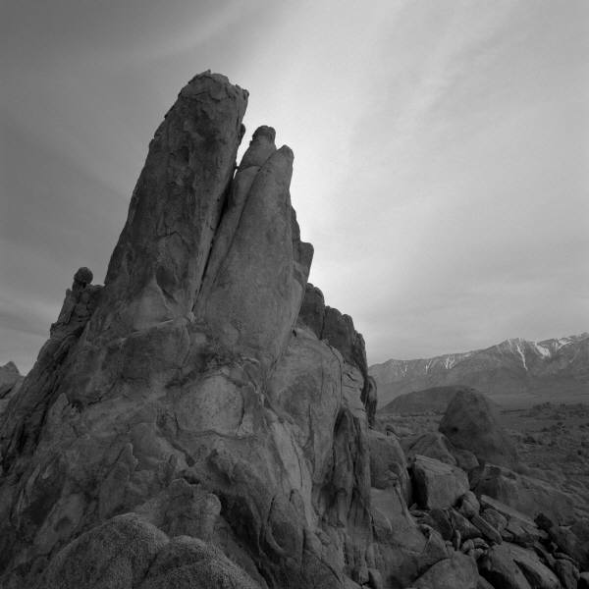
DIGITAL IMAGE PROCESSING

Slide 2
The images used in this presentation can be found here:
https://github.com/dphi-official/Deep_Learning_Bootcamp/tree/master/Digital%20Image%20Processing/images

Slide 3
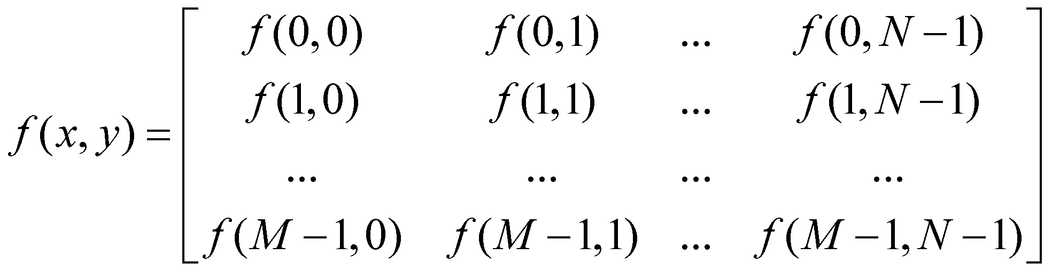
What is Digital Image Processing?
Digital Image:
A representation of a two-dimensional image as a finite set of digital values, called picture elements or pixels. f(x, y)
Where x, y are spatial coordinates
f(x, y) = i(x,y) * r(x,y)
f(x, y): Intensity at given point (x, y) i(x, y): Illumination at (x, y) r(x, y): Reflectance/ Transmissivity at (x, y)
M XN representation of f

Slide 4
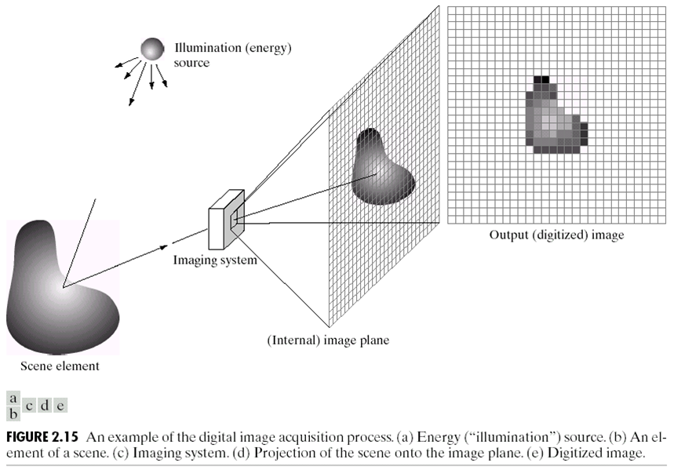
Image Acquisition Process

Slide 5
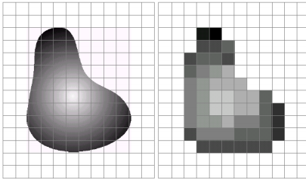
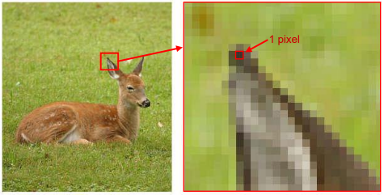
Pixel & Digitization
Pixels are the elements of a digital image that typically represent gray levels, colours, heights, opacities.
Digitization implies that a digital image is an approximation of a real scene in the numerical matrices form

Slide 6
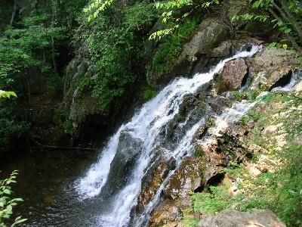

Digital Image
Common digital image formats include
1 sample per point (B&W / Grayscale)
3 samples per point ( Red, Green and Blue)
4 samples per point (Red, Green, Blue and Alpha / opacity)

Slide 7

What is Digital Image Processing?
Digital Image Processing:
Processing digital images by means of a computer.
An image processing operation typically defines a new image g in terms of an existing image f.
We can transform either the range of f.
Or the domain of f:

Slide 8
Why Digital Image Processing?
- Improvement of pictorial information for human interpretation
Processing of image data for storage, transmission and representation for autonomous machine perception
Where image processing ends, fields such as image analysis and computer vision start.
The continuum from image processing to computer vision is broken down into:
Low – Level:
Inputs and outputs are images
Ex: Noise Removal, Image Sharpening
Mid – Level:
Outputs are the attributes extracted from input images
Ex: Object Recognition, Image Segmentation
High – Level:
An ensemble of recognition of individual objects
Ex: Scene Understanding, Autonomous Navigation
For more details about each of the steps in the next set of slides refer this article: https://medium.com/futframe-ai/fundamental-steps-of-digital-image-processing-d7518d6bb23c

Slide 9
Key Stages in Digital Image Processing
Image Restoration
Morphological Processing
Image Enhancement
Segmentation
Image Acquisition
Object Recognition
Representation & Description
Problem Domain
Colour Image Processing
Image Compression

Slide 10
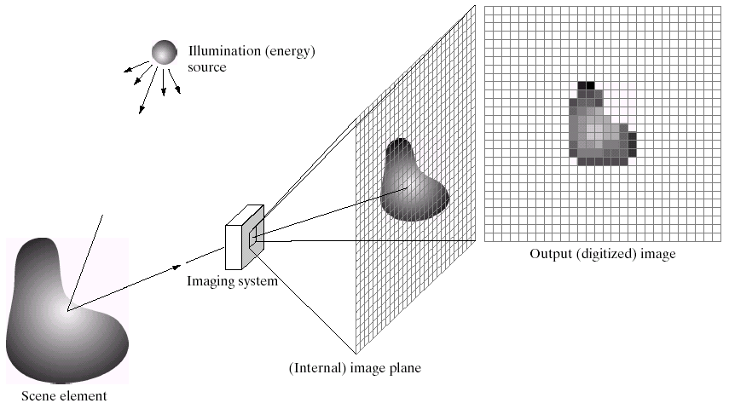
KEY STAGES IN DIGITAL IMAGE PROCESSING: IMAGE ACQUISITION
Image Restoration
Morphological Processing
Image Enhancement
Segmentation
Image Acquisition
Object Recognition
Representation & Description
Problem Domain
Colour Image Processing
Image Compression

Slide 11
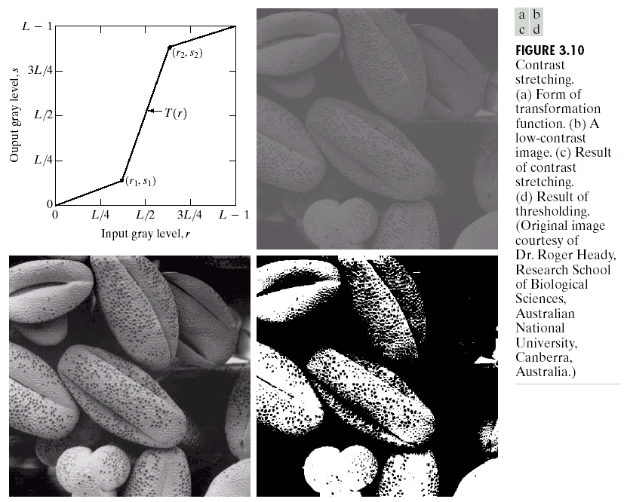
KEY STAGES IN DIGITAL IMAGE PROCESSING: IMAGE ENHANCEMENT
Image Restoration
Morphological Processing
Image Enhancement
Segmentation
Image Acquisition
Object Recognition
Representation & Description
Problem Domain
Colour Image Processing
Image Compression

Slide 12
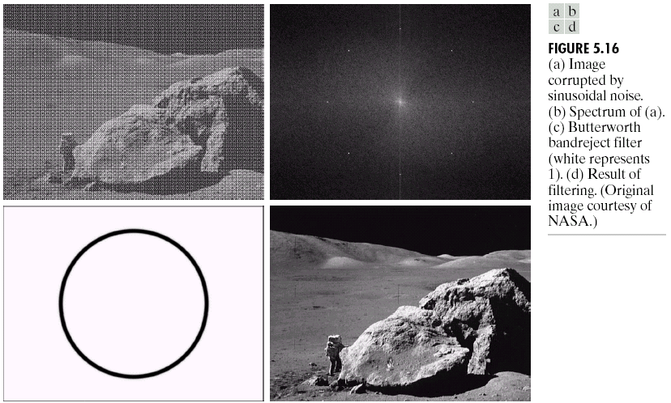
KEY STAGES IN DIGITAL IMAGE PROCESSING: IMAGE RESTORATION
Image Restoration
Morphological Processing
Image Enhancement
Segmentation
Image Acquisition
Object Recognition
Representation & Description
Problem Domain
Colour Image Processing
Image Compression

Slide 13
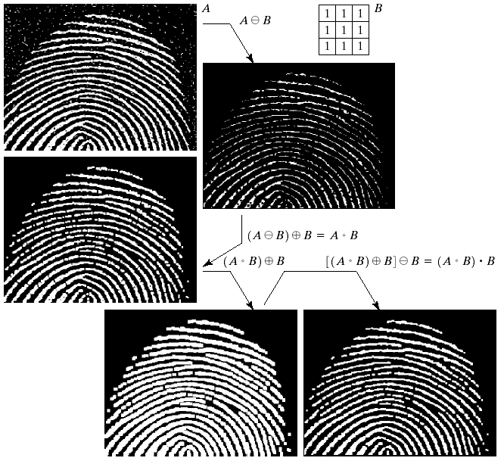
KEY STAGES IN DIGITAL IMAGE PROCESSING: MORPHOLOGICAL PROCESSING
Image Restoration
Morphological Processing
Image Enhancement
Segmentation
Image Acquisition
Object Recognition
Representation & Description
Problem Domain
Colour Image Processing
Image Compression

Slide 14
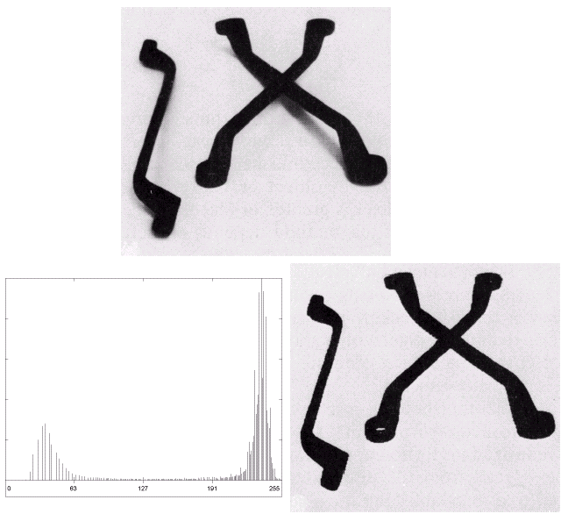
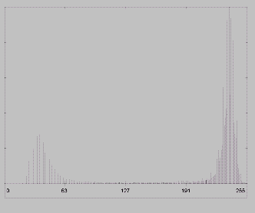
KEY STAGES IN DIGITAL IMAGE PROCESSING: SEGMENTATION
Image Restoration
Morphological Processing
Image Enhancement
Segmentation
Image Acquisition
Object Recognition
Representation & Description
Problem Domain
Colour Image Processing
Image Compression

Slide 15
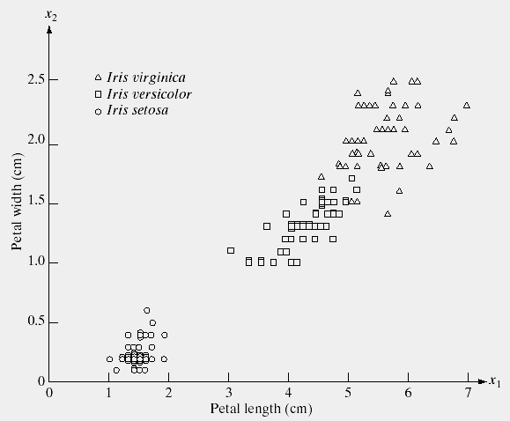
KEY STAGES IN DIGITAL IMAGE PROCESSING: OBJECT RECOGNITION
Image Restoration
Morphological Processing
Image Enhancement
Segmentation
Image Acquisition
Object Recognition
Representation & Description
Problem Domain
Colour Image Processing
Image Compression

Slide 16
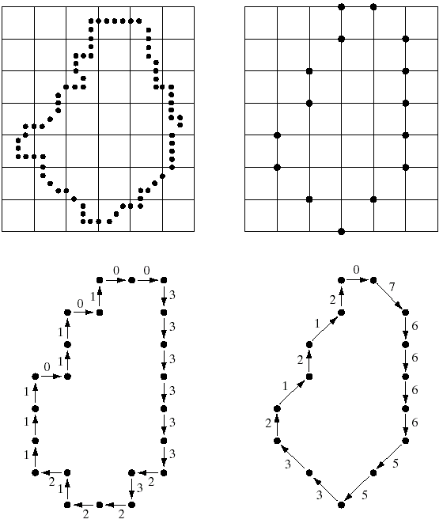
KEY STAGES IN DIGITAL IMAGE PROCESSING: REPRESENTATION
Image Restoration
Morphological Processing
Image Enhancement
Segmentation
Image Acquisition
Object Recognition
Representation & Description
Problem Domain
Colour Image Processing
Image Compression

Slide 17
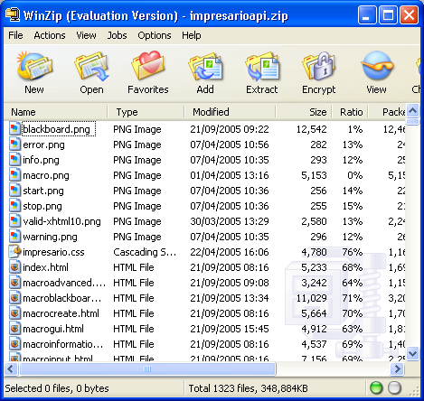
KEY STAGES IN DIGITAL IMAGE PROCESSING: COMPRESSION
Image Restoration
Morphological Processing
Image Enhancement
Segmentation
Image Acquisition
Object Recognition
Representation & Description
Problem Domain
Colour Image Processing
Image Compression

Slide 18
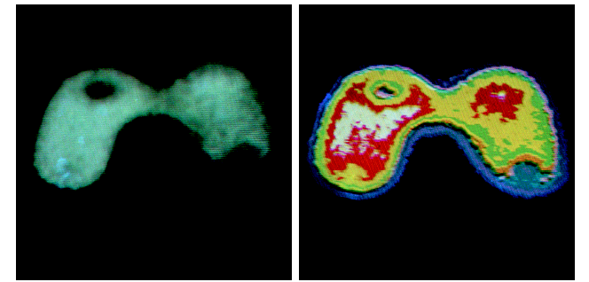
KEY STAGES IN DIGITAL IMAGE PROCESSING: COLOUR PROCESSING
Image Restoration
Morphological Processing
Image Enhancement
Segmentation
Image Acquisition
Object Recognition
Representation & Description
Problem Domain
Colour Image Processing
Image Compression

Slide 19
APPLICATIONS
Document Handling
Signature Verification
Biometric Verification
Object Recognition Research
Target Recognition
Interpretation of aerial photography
Autonomous Vehicle
Traffic Monitoring
Face Recognition and Tracking
Medical Applications -> Tumor detection
Image generations
Image styling

Slide 20
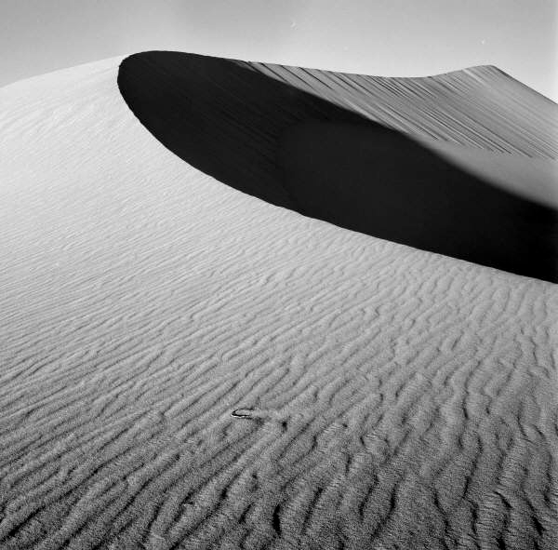
THANK YOU Banu Prakash

